Slide 1
The Genesis of
Physical AI

Slide 2



Executive Summary
A Structural Inflection Point
The Pivot
The frontier has moved toward embodied AI, spatial intelligence, and physical AI.
The AI landscape has decisively departed from language-centric paradigms. The physical world is irreducible: governed by occlusion, complex geometry, causality, and multi-dimensional physics that no corpus of written text fully encodes.
The Substrate
World models are the computational surrogate of the environment, enabling simulative reasoning.
The Fuel
Synthetic data is a rigorous manufacturing discipline, critical for bridging the physical gap.

Slide 3
PART 01
Macro Evolution, Frontier AI Scaling,
and Economic Dynamics
The shift from autoregressive text to physical domain integration, the economics of compute, and the exhaustion of public data.

Slide 4



The Four Epochs of Machine Intelligence
Each epoch's marginal unit of new capability became progressively more expensive, culminating in the necessity of physical simulation.
1. Supervised Discriminative (Pre-2018)
2. Autoregressive Pretraining (2018-2023)
Signal: Human-annotated labels.
Competence was bounded by manual labeling cost. Resulted in narrow generalization.
Signal: Raw internet text.
Enabled scaling laws but resulted in hallucination and lacked true grounding in physical causality.
3. Test-Time Reasoning (2023-2025)
4. Embodied Physical AI (2025-Present)
Signal: Inference-time deliberation.
Signal: Interaction & Simulation.
Monte Carlo tree search layered on pretrained weights. Shifted cost to inference compute. Capable but unembodied.
World models grounded in 3D space, contact physics, and closed-loop action. The final frontier of capability scaling.

Slide 5

The Data Exhaustion Crisis
The Compute Wall
The public, human-generated text corpus available for training is projected to be effectively exhausted by frontier-scale training runs between 2027 and 2028.
2028
Simultaneously, beyond 10^{27} FLOPs, progress is bottlenecked by gigawatt-scale power availability at datacenter sites a grid-infrastructure constraint, not a silicon constraint.
Public Text Exhaustion
$10^{14} Tokens Consumed
The Strategic Pivot
The lever for future capability growth is no longer raw capital deployed toward pretraining on public text. It is proprietary synthetic-data generation.

Slide 6
The AI Economic Surge & The Fragile Trust Paradox
$512B
The Fragile Trust Paradox
Massive enterprise deployment coexists with state-of-the-art models that still unpredictably fail basic logical or spatial tasks.
Projected AI Spend by 2027
Enterprise integration cannot scale fully until this fragile trust is resolved. The market increasingly rewards systems that prioritize verifiability over sheer generative capability.
The capital-expenditure supercycle behind AI is unprecedented. 88% of adopting organizations report measurable revenue gains.
Source: The Genesis of Physical AI, 2026. Sec 1.1

Slide 7


The Adoption Gap is Organizational
Individual employees are adopting AI tools faster than organizations can govern them, creating substantial shadow-IT and data-leakage risk.
66%
33%
Report Productivity Gains
Achieve Business Transformation
Two-thirds of organizations report individual task-level productivity gains from AI integration.
Only one-third are genuinely reimagining their business processes around it. The gap is governance, not capability.
Organizations where senior leadership actively shapes AI governance report significantly higher realized business value than those leaving decisions to technical teams.

Slide 8


Scaling Laws Hit the Entropy Floor
Kaplan / Chinchilla Scaling
Historically, AI capability scaled along predictable power-law curves relating cross-entropy loss to model size and dataset size.
▪
$L$: Cross-entropy loss
▪
$E$: Irreducible entropy floor
Compute-optimal training requires parameter count ($N$) and data volume ($D$) to grow in roughly equal proportion for a fixed compute budget.
▪
$N$: Parameter count
▪
$D$: Dataset size
The strategic reality: The floor $E$ does not move, no matter how much larger $N$ or $D$ becomes.

Slide 9



From Training Scale to Test-Time Reasoning
Unified Compute Budget
System 1 vs. System 2
The industry has transitioned to unifying pretraining decisions and test-time execution choices under a single budget.
System 1: Single reflexive forward pass. Fast, cheap, but brittle on novel physical problems.
Rather than building massive, sluggish models, the frontier builds nimble, overtrained systems tested repeatedly under fixed budgets.
System 2: Executes dynamic chain-of-thought, Monte Carlo Tree Search, and self-verification. Slower, expensive, but autonomous and self-correcting.

Slide 10


Where the AI Economy is Moving
-90%
55.8%
$15.7T
Cost of Intelligence
Software Acceleration
Macro Exposure
Raw intelligence is rapidly commoditizing. Open-weight models operate at 25-50x lower cost per token, making raw inference abundant.
Coding is the ultimate proving ground for System 2 AI because compilers provide instantaneous, closed-loop verifiability.
Projected GDP uplift by 2030. Manufacturing and logistics represent >60% of exposure, driving the mandate for Physical AI.

Slide 11
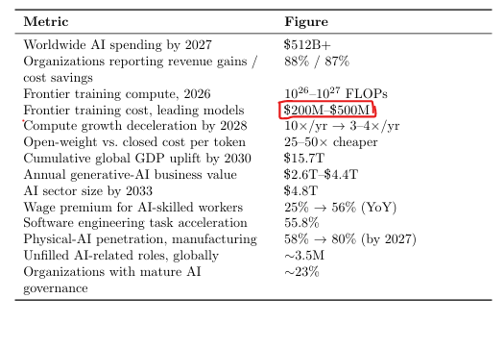

Slide 12
PART 02
World Models: Comparative Status,
Gaps, and Failure Modes
The transition from text-prediction to simulating a Partially Observable Markov Decision Process in multi-dimensional space.

Slide 13
Why Text Intelligence Breaks in Physical Space
Pearl's Causal Ladder
The Formal Substrate (POMDP)
A language model is confined to the associational rung—it recognizes co-occurrence but lacks physical grounding.
An intelligent agent in a physical environment is modeled as a Partially Observable Markov Decision Process:
▪
I. Association: $P(Y|X)$ (LLMs)
▪
II. Intervention: $P(Y|do(u))$ (Robotic action)
A learned world model instantiates this via a compressed latent space ($Z$) enabling tractable simulative reasoning:
▪
III. Counterfactuals: $P(Y_u|X',Y')$ (Planning)
Safe physical execution requires evaluating alternative physical paths *before* acting.

Slide 14


The Three Schools of World Models
1. Renderer School
2. Latent / JEPA
3. Spatial / Engineered
Generative Simulators
Predictive Models
Physics Platforms
Optimizes for photorealistic pixel diffusion. High latency. Severe hallucination risk because visual plausibility does not equal physical correctness.
Rejects pixel rendering for abstract future states in an energy-based latent space. Highly data-efficient with sub-5ms inference latency. Ideal for real-time control.
Uses explicit 3D/4D volumetric occupancy voxels combined with Physics-Informed Neural Networks. High industrial trust due to conservation laws.

Slide 15
Comparative Matrix Across Architectures
Conflating these three schools is a profound strategic error. Each optimizes for a genuinely different objective.
Dimension | Renderer School | Latent / JEPA School | Spatial / Engineered School
Core Technique | Pixel diffusion / autoregressive video | Energy-based latent prediction | 3D/4D voxel occupancy + PINNs
Exemplars | Sora, Genie 1/2, Oasis | V-JEPA, Dreamer V3, TD-MPC2 | Tesla occupancy nets, Isaac Sim
Physics Origin | Emergent (learned incidentally) | Emergent, abstract representation | Explicitly engineered / constrained
Data Efficiency | Low (requires vast video corpus) | High (<62 hrs real robot data) | Medium (simulator-bootstrapped)
Latency | High (seconds per frame) | Very low (sub-5ms feasible) | Low-Medium
Hallucination Risk | High (plausibility $\neq$ correctness) | Low (no pixel generation) | Low (physics-constrained)
Best Use Case | Human-facing content simulation | Safety-critical robotic control | Industrial digital twins, AV

Slide 16

The Value Function & The Benchmark Problem
Value Over Imagined Rollouts
Benchmarking the Benchmarks
An intelligent agent evaluates alternative physical paths before acting. It discounts future rewards inside an imagined world.
Evaluation remains the least mature part of the field. Frontier laboratories still do not publish results to a shared, standardized leaderboard.
Claims that a world model is "state of the art" based on visual fidelity (e.g., LPIPS/SSIM) carry no weight for physical AI, because visual plausibility does not guarantee contact physics or executability.
Intelligence requires an internal simulator of reality, not merely a predictor of the next word.

Slide 17


Failure Modes I: Drift and Executability
FM1: Autoregressive Drift
FM2: The Executability Gap
Single-step latent prediction error compounds over a temporal horizon $T$.
Perceptual losses reward video that looks correct but ignores underlying contact dynamics.
Impact: Objects and layouts drift or are forgotten. Solid walls are bypassed after minutes of simulation. Must be actively monitored via uncertainty diagnostics.
Impact: A visually flawless synthetic action can cause a real robot to shatter a part if the generation violated Coulomb friction. Visual fidelity is structurally insufficient.

Slide 18



Failure Modes II: Hallucination & Marginalization
FM3: Perceptual Hallucination
FM4: Action Marginalization
FM5: The Sim-to-Real Gap
Out-of-distribution inputs (unfamiliar tools, sensor noise) are forced into familiar codebook tokens.
Impact: The model ignores operator input, functioning on a pre-recorded autopilot loop despite changing controls.
Impact: Synthetic data cannot fully replace real-world data due to long-tail friction variability. Dictates a mandatory hybrid strategy.
Impact: Silently corrupts the simulation base state. The system misperceives reality without knowing it.

Slide 19

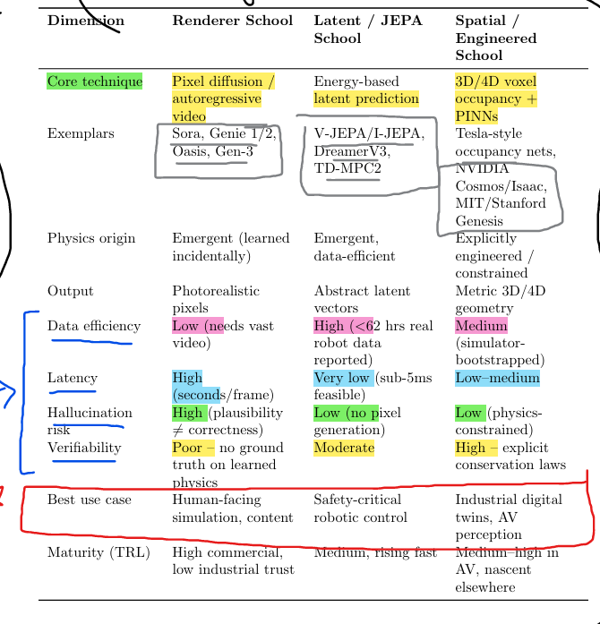
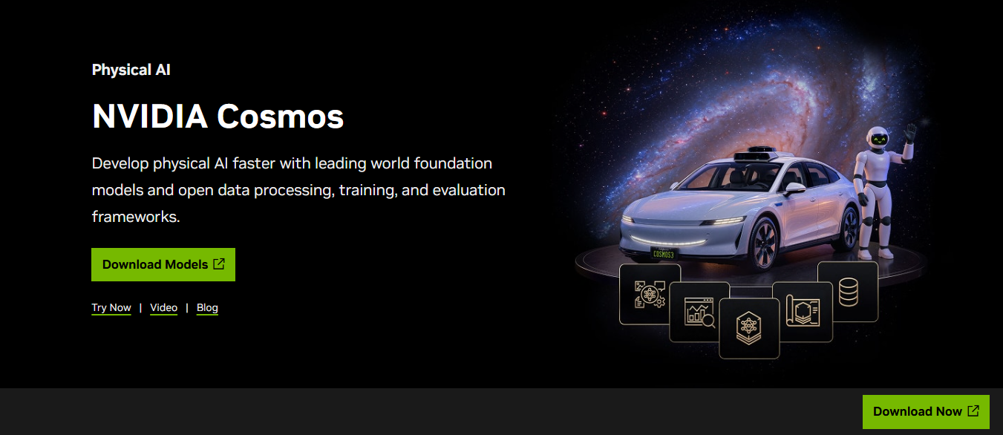
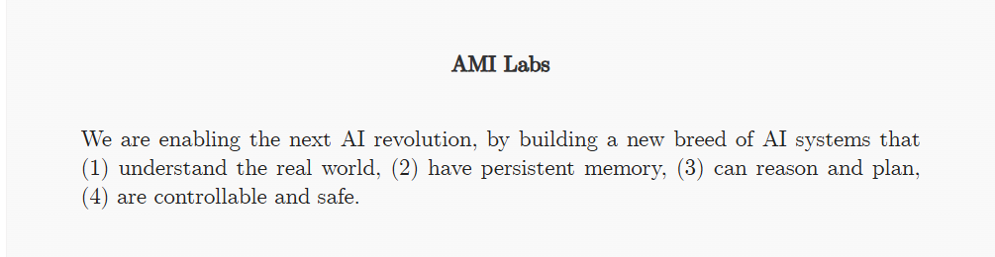

Slide 20
PART 03
Synthetic Data as the
Connective Tissue
Bridging the exhaustion of human data and the physical execution gap through rigorous manufacturing discipline.

Slide 21

A Working Taxonomy of Synthetic Data
Synthetic data is a governed manufacturing discipline, not a shortcut. Each tier trades scale for certainty.
Tier 1
Tier 2
Tier 3
Tier 4
Model-Generated Reasoning Traces
Statistically Grounded Tabular
Simulated Spatial Telemetry
Formally Verified Data
Lean 4, SMT solvers, ASIC-grade formal verification. Expensive, but carries mathematical guarantees.
Tree search, self-play, compiler-verified code execution. Cheap and abundant but bounded by the verifier.
Copulas, DP-GANs. Validated by Kolmogorov-Smirnov test validation.
3D Gaussian Splats, NeRFs, Isaac Sim rollouts. Critical for physical AI edge cases.

Slide 22


The Model Collapse Risk
Replace Collapse
Indiscriminate recursive training on unfiltered outputs drives variance to zero, causing models to forget the tails of the true distribution.
The Consequence
If a model only studies from textbooks it wrote itself, it loses the rare edge cases that matter most for physical safety.

Slide 23


Accumulation, Curation, and GRPO
The Accumulate-and-Filter Resolution
Synthetic Reasoning (GRPO)
Mix curated synthetic data with retained real data at a carefully maintained ratio ($\alpha$) to prevent collapse.
Group Relative Policy Optimization forces step-by-step reasoning autonomously via programmatic verifiers (e.g., physics collision engines).
Every dataset must state its ratio $\alpha$ and its programmatic verifier mechanism.
Quality outweighs quantity: 1,000 verified manipulation trajectories beat 1,000,000 unfiltered rollouts.

Slide 24

World Models as Data Engines
World-foundation-model platforms are explicitly trained to manufacture synthetic training data, not merely to render impressive demonstrations.
The Transformation
▪
80% reduction in automation setup time.
The Apex Use Case: Autonomous Driving. Top-tier teams treat synthetic scenario generation as core infrastructure. Engineers generate thousands of synthetic scenarios (e.g., a child running into the street) so the system learns to brake correctly without risking a human life.
▪
40% reduction in operational costs.
▪
50% accelerated time-to-market.
World models are the factories manufacturing the fuel Physical AI needs to learn.

Slide 25



Physics Verification & Uncertainty Diagnostics
Physics-Informed Neural Networks
Real-Time Uncertainty Signals
PINNs enforce hard boundary conditions (mass, energy, momentum) directly into the generation pipeline, closing the executability gap.
Aleatoric: Reconstruction residual measures how well the model reconstructs a true observation.
Epistemic: Inter-seed variance measures how much predictions vary across seeds (model confidence).

Slide 26





The Closed-Loop Flywheel Architecture
A world model trains on real data, generates verified synthetic data to train physical-AI agents, which deploy into the real world to collect new data, closing the loop.
Telemetry
Calibration
Generation
Deployment
Logging
Sparse, noisy real-world industrial telemetry ingested from the field.
World model calibrated against telemetry, anchoring to reality.
Large-scale synthetic edge cases generated and PINN physics-verified.
Zero-shot policy deployment into target environments.
Uncertainty-flagged outcomes fed back into Stage 1 to retrain.

Slide 27


Governance is a Structural Component
A minimum viable provenance practice requires four operational controls. Governance must be operationally enforceable, not merely stated as policy.
1. Dataset Cards
2. Fingerprinting
Every synthetic batch ships with a machine-readable record of its generating model version, its verifier, and its measured pass rate.
Synthetic samples are tagged to allow future audits to definitively determine the synthetic-vs-real fraction of any training set.
3. Ratio Enforcement
4. Periodic Re-anchoring
The accumulation ratio ($\alpha$) is a strict build parameter. Pipelines that silently drift higher in synthetic fraction trigger collapse.
The real-data fraction is refreshed on a fixed cadence to prevent the world model from drifting away from current physical realities.

Slide 28
From Theory to Industrial Deployment
Engineering Models $\neq$ Video Generators
Federated Co-Development
The most durable arrangement is symbiotic:
Commercial world models optimize for visual plausibility. Engineering-grade models optimize for physical invariants: structural load tensors, thermodynamics, and conservation laws.
▪
Partner A (Incumbent): Contributes unstructured industrial telemetry, real-world distribution, and domain oversight.
Conflating the two is the most consequential category error a technical evaluation can make.
▪
Partner B (Specialist): Contributes train-to-test architecture, reasoning loops, and physics-calibrated generation.
Compute talent does not substitute for industrial trust.

Slide 29
A Practical Evaluation Framework
Evaluation Axis | What to Demand (Verification Criteria)
School Identification | Which school (Renderer, Latent, Spatial) does this platform belong to? Does it match safety-critical needs?
Long-Horizon Consistency | Demand measured drift bounds ($\mathbb{E}[||\hat{z}_T - z_T||]$) at increasing horizons, not a single demo.
Executability Proof | Evidence actions are tested against contact dynamics, not just perceptual metrics (LPIPS/SSIM).
Collapse Governance | Explicit accumulation ratio ($\alpha$) and verifier identity for every synthetic dataset.
Uncertainty Exposure | Are reconstruction residual and inter-seed variance exposed at inference to flag blind spots?
Sim-to-Real Honesty | The honest position is a stated hybrid ratio of synthetic to real data, not claims of 100% synthetic parity.
Benchmark Provenance | Is the result published against a shared leaderboard, or a self-reported internal comparison?

Slide 30

The Industrial Test Case & Strategic ROI
Scenario: Robotic Arm Handling
The Strategic Conclusion
Challenge: Handling a new part variant with sparse real-world data (low hundreds of examples).
This architecture shifts CapEx from physical prototyping to scalable, OpEx-driven computational simulation—accelerating time-to-market and strengthening regulatory compliance.
1.
School: Select Spatial/Engineered (measured geometry + contact dynamics).
2.
Generation: Create 1,000s of trajectories checked against PINN loss for physical plausibility.
"The actual competition is not achieving the highest benchmark, but executing data-governance and physical engineering discipline most rigorously."
3.
Governance: Enforce accumulation ratio $\alpha$ with real handling data.
4.
Deployment: Execute policy while monitoring reconstruction residual for real-time uncertainty flagging.

